Slide 1

Seminar 18
UBIQUITOUS SENSOR NETWORK LABORATORY
Department of Electronics Engineering, Keimyung University
10th March 2017
By Tran Viet Cuong

Slide 2
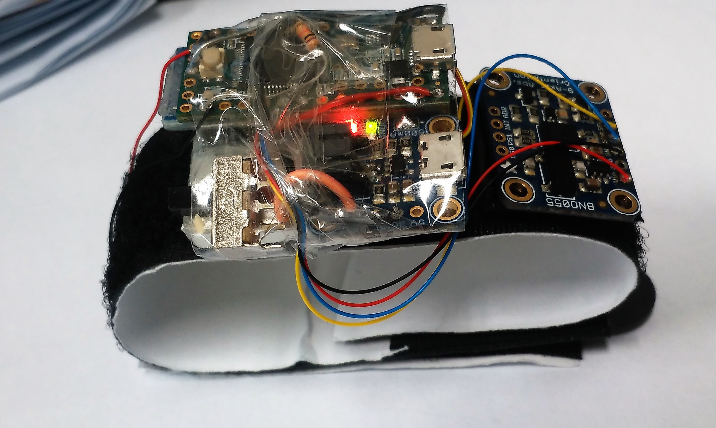
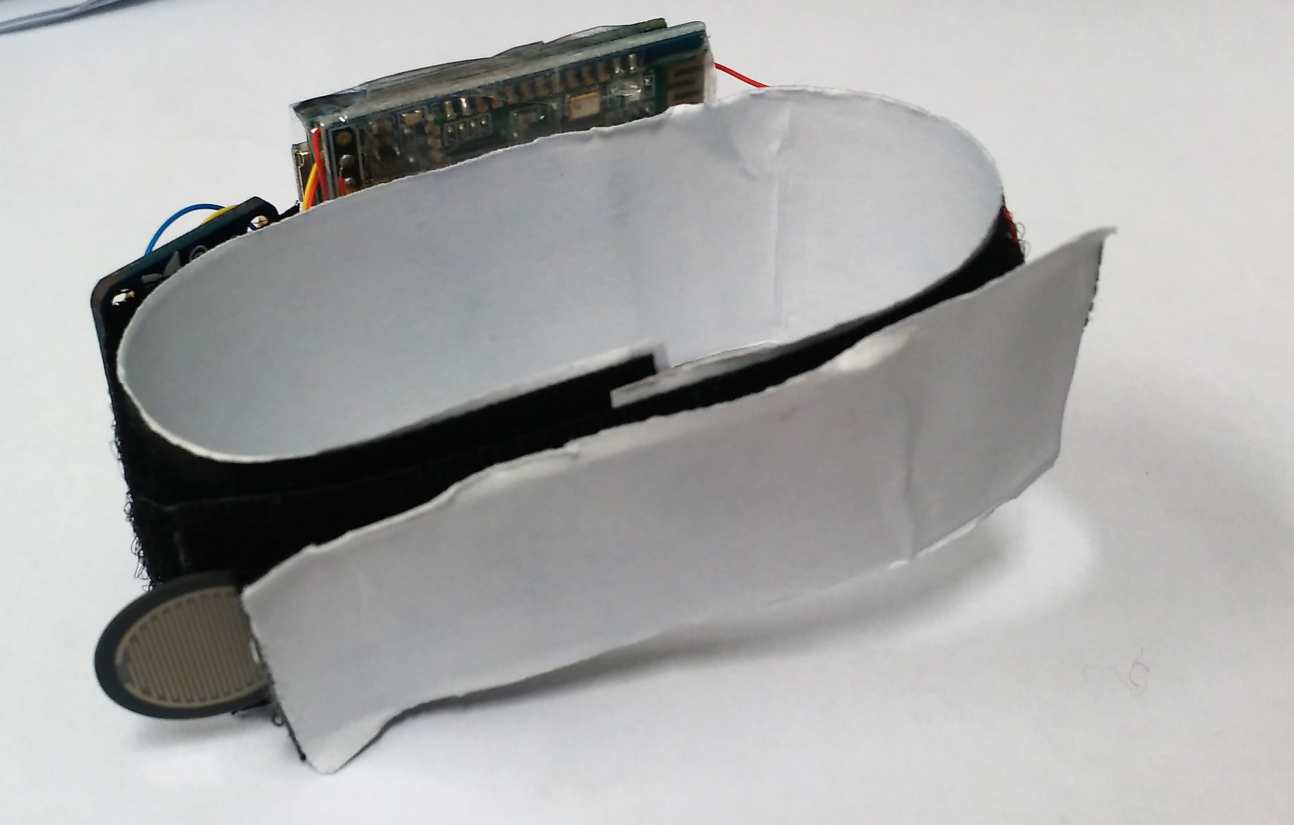
Ring Gesture

Slide 3
The remaining work for ring gesture project:
Clustering the data
Try to make standalone system (ARM 32bit, C++)
Application: Control quadcopter and Home Automation
3D printer and PCB board

Slide 4

Next
Finish paper
Learn more deeply into C++, Qt platform
Build quadcopter

Slide 5
THANK YOU!
UBIQUITOUS SENSOR NETWORK LABORATORY

Slide 6
Any Questions ?
UBIQUITOUS SENSOR NETWORK LABORATORY

